Slide 1
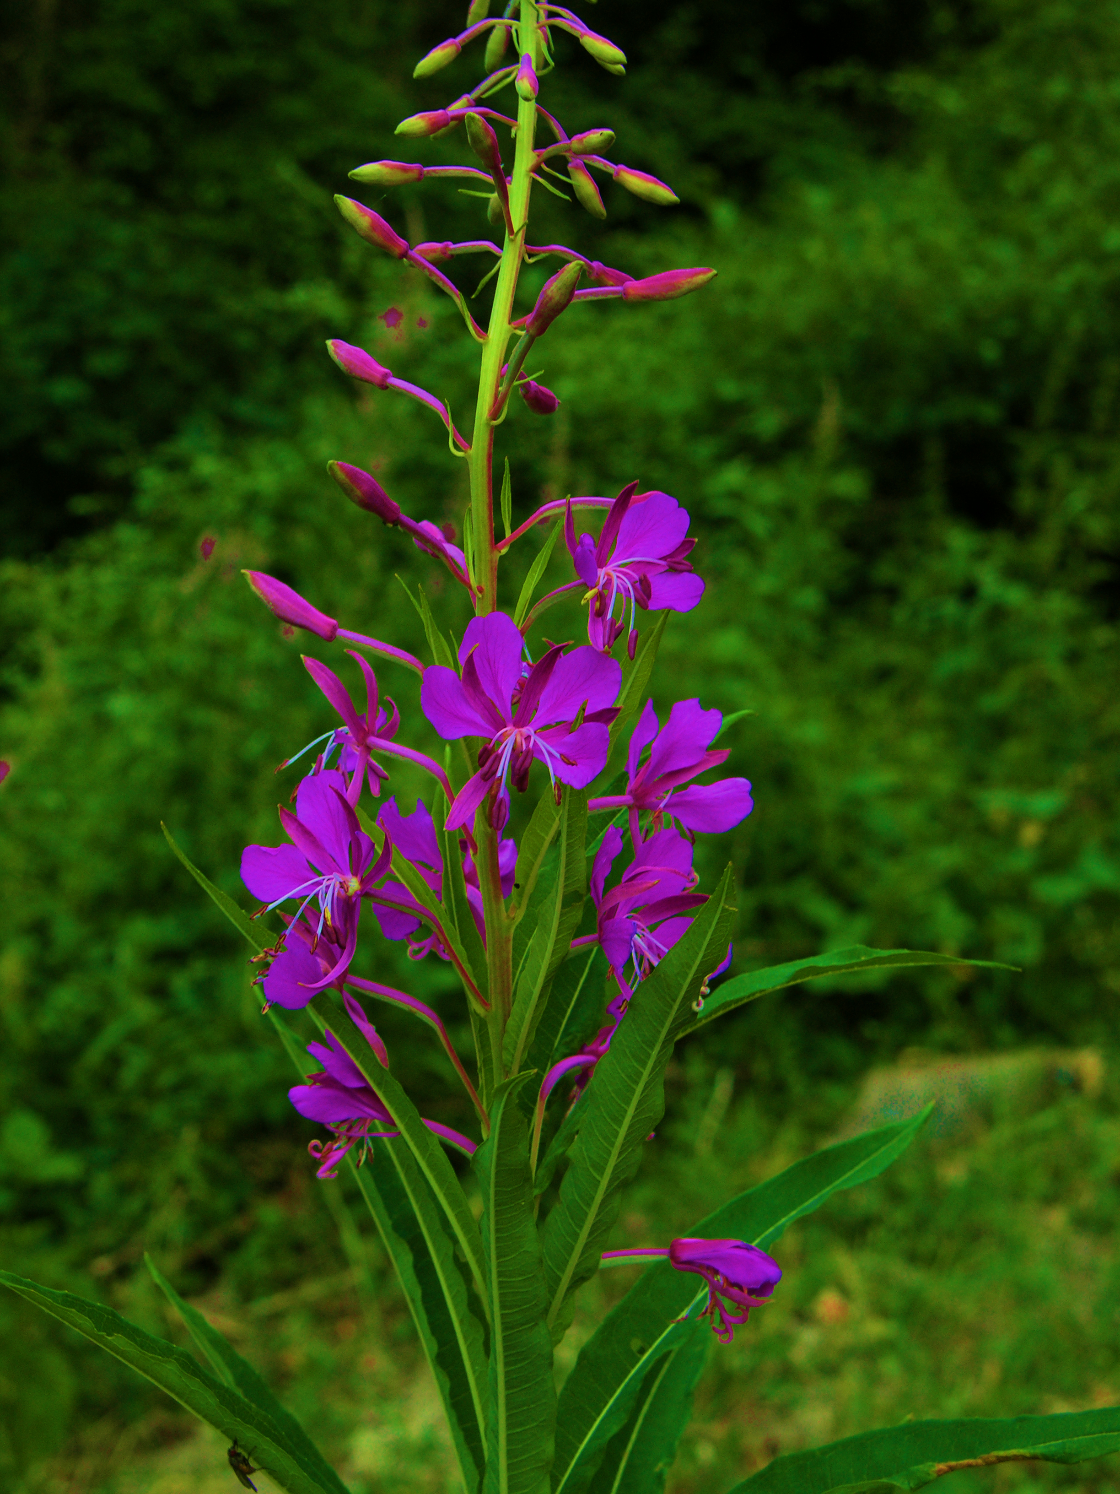

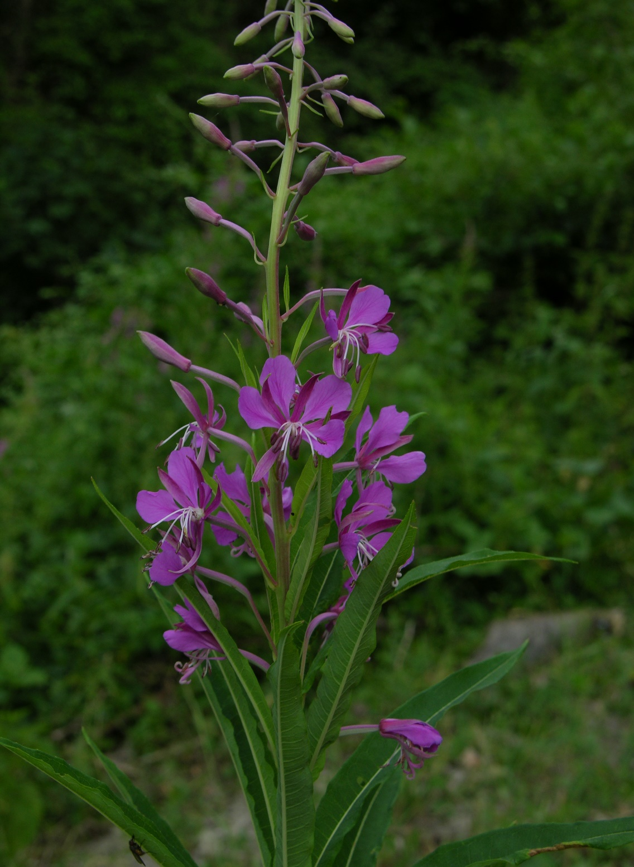

Microencapsulation of willowherb leaves extract with maltodextrin and whey protein using spray drying
Miloš S. Jovanović¹, Zorica N. Drinić¹, Dubravka J. Bigović¹, Gordana M. Zdunić¹, Jelena R. Mudrić¹, Katarina P. Šavikin¹
¹Institute for Medicinal Plants Research “Dr. Josif Pančić”, Tadeuša Košćuška 1, 11000 Belgrade, Serbia
Introduction
Results and Discussion
Willowherb (Epilobium angustifolium L.) leaves are valuable source of polyphenolic compounds (phenolic acids, flavonoids and ellagitannins) that are mainly used in the treatment of benign prostatic hyperplasia.
Spray drying as a fast, inexpensive, affordable, and flexible technique is the most commonly used method for encapsulating unstable compounds such as polyphenols on an industrial scale. Choosing the optimal carriers is one of the key steps in the development of the appropriate encapsulation process.
In the presented research, the influences of maltodextrin and whey protein as carriers on the efficiency of spray drying and physicochemical properties of the obtained extract powders were investigated.
The use of carriers significantly improved the drying yield (63.76% and 63.18% for extracts with maltodextrin and whey protein, compared to 47.75% for extract without carrier).
Whey protein has shown significantly better encapsulation efficiency of polyphenolic compounds (92.02%) compared to maltodextrin (75.80%). Similar to phenols, higher encapsulation efficiency was achieved in the case of whey protein (94.34%) compared to maltodextrin (93.00%) but this difference was not statistically significant.
The moisture content (below 5%) and hygroscopicity (below 20%) of all dried extracts (without carrier, with maltodextrin and whey protein) were at an acceptable level to ensure microbiological stability.
The time required to rehydrate the extracts in the aqueous medium was 30 seconds for both extracts with carriers, and 20 seconds for the extract without carriers. Relatively short rehydration time of dry extracts provides the possibility to use them in the form of instant teas.
Material and Methods
Willowherb leaves were obtained from the Institute for Medicinal Plants Research “Dr. Josif Pančić“. Liquid extract was prepared by decoction with solid to solvent ration 1:20.
The spray drying technique with 20% maltodextrin and whey protein as carrier agents were applied for encapsulation of willowherb leaves extract. Encapsulation efficiency of total phenolics and total flavonoids were monitored by spectrophotometric Folin-Ciocalteu and aluminum chloride complexation assay, respectively. Moisture content, hygroscopicity during one week, and rehydration time were determined for powder samples.
Conclusion
The use of carrier agents significantly improved the drying yield which is accompanied by the high encapsulation efficiency of total polyphenols and flavonoids. Therefore, willowherb leaves extract can be successfully encapsulated by spray drying using maltodextrin and whey protein as carriers.
Acknowledgement: Ministry of Education, Science and Technological Development of Republic of Serbia, contract number 451-03-68/2020-14/200003.

